Slide 1
Instruction formats

Slide 2
Instruction Formats
Instruction sets are differentiated by the following:
  Number of bits per instruction.
  Stack-based or register-based.
  Number of explicit operands per instruction.
  Operand location.
  Types of operations.
  Type and size of operands.

Slide 3
Instruction Formats
Instruction set architectures are measured according to:
  Main memory space occupied by a program.
  Instruction complexity.
  Instruction length (in bits).
  Total number of instructions in the instruction set.

Slide 4
Instruction Formats
In designing an instruction set, consideration is given to:
  Instruction length.
    Whether short, long, or variable.
  Number of operands.
  Number of addressable registers.
  Memory organization.
    Whether byte- or word addressable.
  Addressing modes.
    Choose any or all: direct, indirect or indexed.

Slide 5
Instruction Formats
Byte ordering, or endianness, is another major architectural consideration.
If we have a two-byte integer, the integer may be stored so that the least significant byte is followed by the most significant byte or vice versa.
  In little endian machines, the least significant byte is followed by the most significant byte.
  Big endian machines store the most significant byte first (at the lower address).

Slide 6
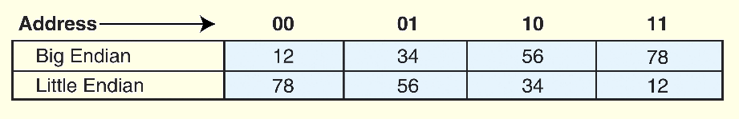
Instruction Formats
As an example, suppose we have the hexadecimal number 12345678.
The big endian and small endian arrangements of the bytes are shown below.

Slide 7
Instruction Formats
Big endian:
  Is more natural.
  The sign of the number can be determined by looking at the byte at address offset 0.
  Strings and integers are stored in the same order.
Little endian:
  Makes it easier to place values on non-word boundaries.
  Conversion from a 16-bit integer address to a 32-bit integer address does not require any arithmetic.

Slide 8
Instruction Formats
The next consideration for architecture design concerns how the CPU will store data.
We have three choices:
  1. A stack architecture
  2. An accumulator architecture
  3. A general purpose register architecture.
In choosing one over the other, the tradeoffs are simplicity (and cost) of hardware design with execution speed and ease of use.

Slide 9
Instruction Formats
In a stack architecture, instructions and operands are implicitly taken from the stack.
  A stack cannot be accessed randomly.
In an accumulator architecture, one operand of a binary operation is implicitly in the accumulator.
  One operand is in memory, creating lots of bus traffic.
In a general purpose register (GPR) architecture, registers can be used instead of memory.
  Faster than accumulator architecture.
  Efficient implementation for compilers.
  Results in longer instructions.

Slide 10
Instruction Formats
Most systems today are GPR systems.
There are three types:
  Memory-memory where two or three operands may be in memory.
  Register-memory where at least one operand must be in a register.
  Load-store where no operands may be in memory.
The number of operands and the number of available registers has a direct affect on instruction length.

Slide 11
Instruction Formats
Stack machines use one - and zero-operand instructions.
LOAD and STORE instructions require a single memory address operand.
Other instructions use operands from the stack implicitly.
PUSH and POP operations involve only the stack’s top element.
Binary instructions (e.g., ADD, MULT) use the top two items on the stack.

Slide 12
Instruction Formats
Stack architectures require us to think about arithmetic expressions a little differently.
We are accustomed to writing expressions using infix notation, such as: Z = X + Y.
Stack arithmetic requires that we use postfix notation: Z = XY+.
  This is also called reverse Polish notation, (somewhat) in honor of its Polish inventor, Jan Lukasiewicz (1878 - 1956).

Slide 13
Instruction Formats
The principal advantage of postfix notation is that parentheses are not used.
For example, the infix expression,
Z = (X × Y) + (W × U),
becomes:
Z = X Y × W U × +
in postfix notation.

Slide 14
Instruction Formats
In a stack ISA, the postfix expression,
Z = X Y × W U × +
might look like this:
PUSH X
PUSH Y
MULT
PUSH W
PUSH U
MULT
ADD
PUSH Z
Note: The result of a binary operation is implicitly stored on the top of the stack!

Slide 15
Instruction Formats
In a one-address ISA, like MARIE, the infix expression,
Z = X × Y + W × U
looks like this:
LOAD X
MULT Y
STORE TEMP
LOAD W
MULT U
ADD TEMP
STORE Z

Slide 16
Instruction Formats
In a two-address ISA, (e.g.,Intel, Motorola), the infix expression,
Z = X × Y + W × U
might look like this:
LOAD R1,X
MULT R1,Y
LOAD R2,W
MULT R2,U
ADD R1,R2
STORE Z,R1
Note: One-address ISAs usually require one operand to be a register.

Slide 17
Instruction Formats
With a three-address ISA, (e.g.,mainframes), the infix expression,
Z = X × Y + W × U
might look like this:
MULT R1,X,Y
MULT R2,W,U
ADD Z,R1,R2

Slide 18
Instruction Formats
We have seen how instruction length is affected by the number of operands supported by the ISA.
In any instruction set, not all instructions require the same number of operands.
Operations that require no operands, such as HALT, necessarily waste some space when fixed-length instructions are used.
One way to recover some of this space is to use expanding opcodes.

Slide 19
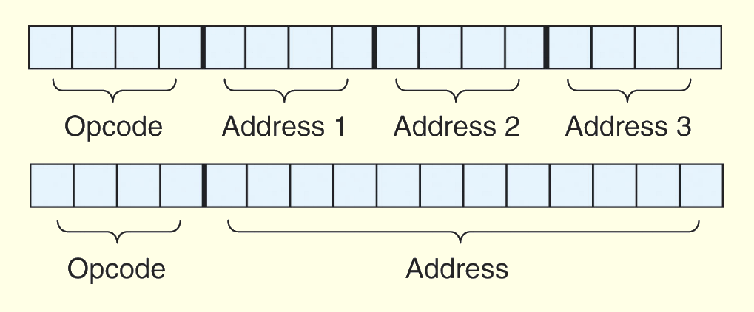
Instruction Formats
A system has 16 registers and 4K of memory.
We need 4 bits to access one of the registers. We also need 12 bits for a memory address.
If the system is to have 16-bit instructions, we have two choices for our instructions:

Slide 20
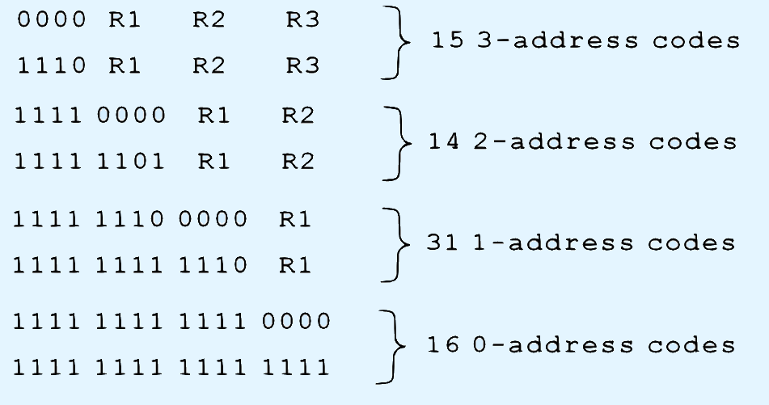
Instruction Formats
If we allow the length of the opcode to vary, we could create a very rich instruction set:

Slide 21
Instruction types
Instructions fall into several broad categories that you should be familiar with:
  Data movement.
  Arithmetic.
  Boolean.
  Bit manipulation.
  I/O.
  Control transfer.
  Special purpose.

Slide 22
Addressing
Addressing modes specify where an operand is located.
They can specify a constant, a register, or a memory location.
The actual location of an operand is its effective address.
Certain addressing modes allow us to determine the address of an operand dynamically.

Slide 23
Addressing
Immediate addressing is where the data is part of the instruction.
Direct addressing is where the address of the data is given in the instruction.
Register addressing is where the data is located in a register.
Indirect addressing gives the address of the address of the data in the instruction.
Register indirect addressing uses a register to store the address of the address of the data.

Slide 24
Addressing
Indexed addressing uses a register (implicitly or explicitly) as an offset, which is added to the address in the operand to determine the effective address of the data.
Based addressing is similar except that a base register is used instead of an index register.
The difference between these two is that an index register holds an offset relative to the address given in the instruction, a base register holds a base address where the address field represents a displacement from this base.

Slide 25
Addressing
In stack addressing the operand is assumed to be on top of the stack.
There are many variations to these addressing modes including:
  Indirect indexed.
  Base/offset.
  Self-relative
  Auto increment - decrement.
We won’t cover these in detail.

Slide 26
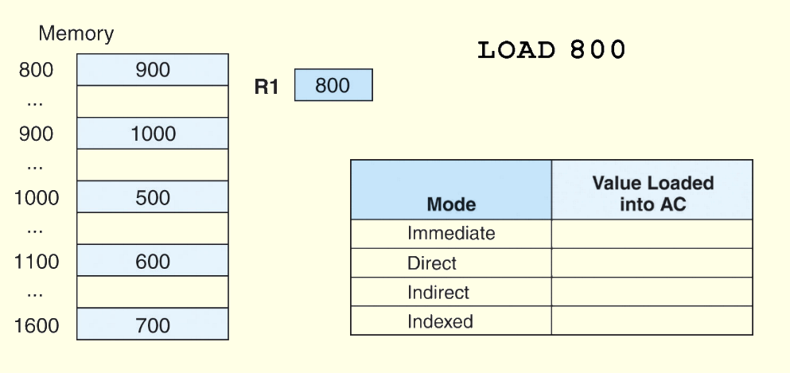
Addressing
For the instruction shown, what value is loaded into the accumulator for each addressing mode?

Slide 27
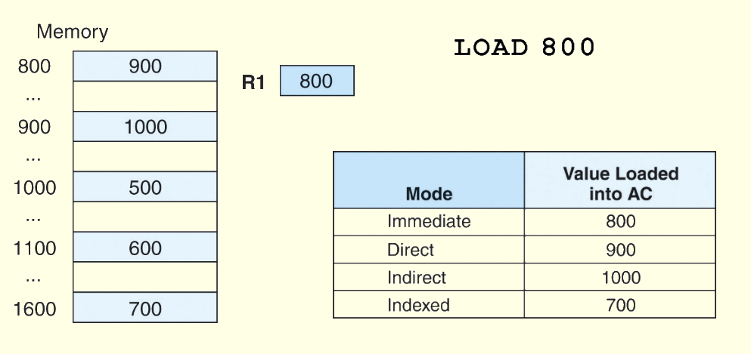
Addressing
These are the values loaded into the accumulator for each addressing mode.

